Slide 1
An augmented reality debugging system for robot swarms
Alistair Jewers
Supervisor – Alan Millard

Slide 2
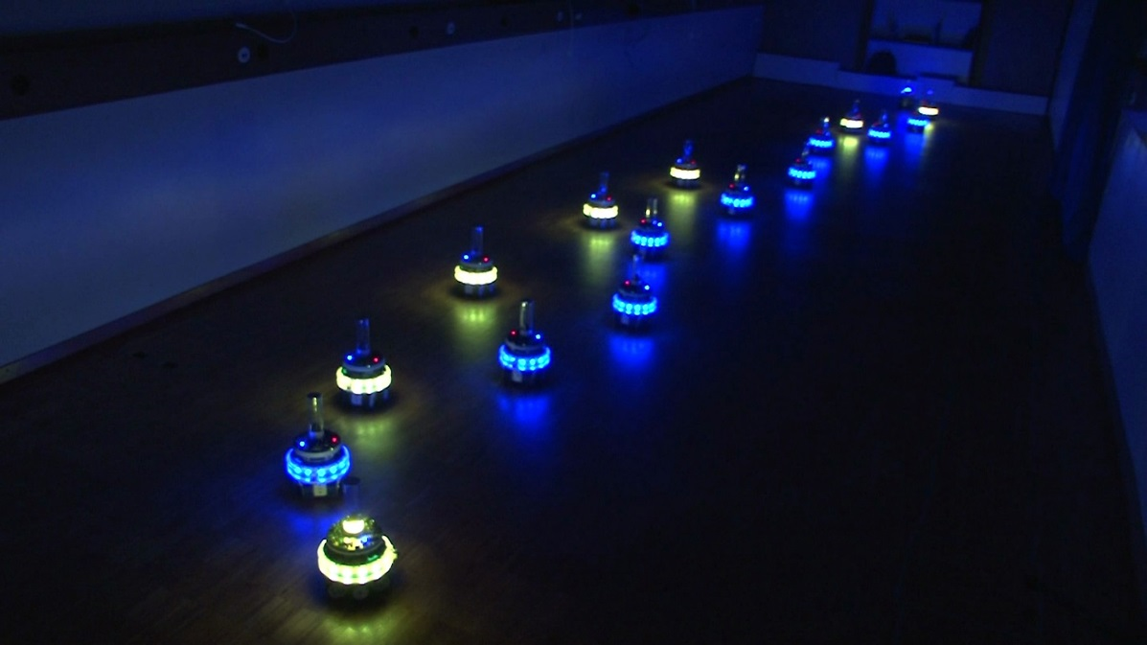
Swarm Robotics
introduction
Relatively new area of research
Specific kind of multi-robot system
Large number of relatively simple robots working together
Decentralised control - local information only
Originated from swarm intelligence and the study of social insects
Unique challenges in development and debugging
Large numbers of robots
No central information point
Ducatelle F., Di Caro G. A., Pinciroli C., Mondada F. and Gambardella L. M., Communication assisted navigation in robotic swarms: self-organization and cooperation. Proceedings of the IEEE/RSJ International Conference on Intelligent Robots and Systems (IROS), San Francisco, USA, September 25-30, 2011

Slide 3
Robotics debugging tools
introduction
Robotic systems differ from traditional software
Real world environment
Greater numbers of inputs
Wider ranges of possible input values
More difficult to isolate issues, reproduce faults, and fix bugs
Problem amplified when working with multi-robot systems such as swarms
Traditional text-based debugging tools not always sufficient
New tools needed to retrieve and display system information in real time

Slide 4
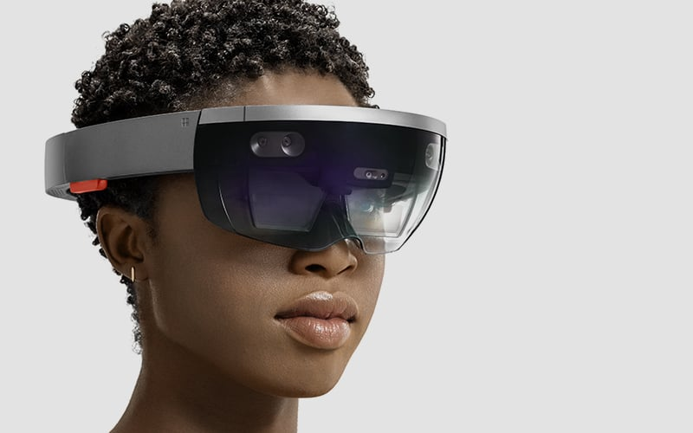
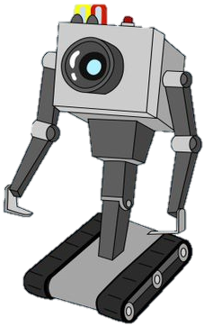
Augmented reality
introduction
AR presents new opportunities for robotics debugging
An augmented combines a real space and a digital one
Can be inherently understood by both humans and robots
Broadens the human-robot communication channel
Humans can parse physical spaces much faster than text or numbers
Microsoft HoloLens. © Microsoft corporation. https://www.microsoft.com/microsoft-hololens/en-us/hardware

Slide 5
Project concept
introduction
Aims to create a software tool for monitoring and debugging robot swarms
Will incorporate a live video feed of the robots
Connect to the robots wirelessly and retrieve internal data
Augment the video feed with graphical representations of the retrieved data
ROBOT1
STATE: IDLE
Raw video of robots
Robots transmit data
Video augmented with data representations

Slide 6
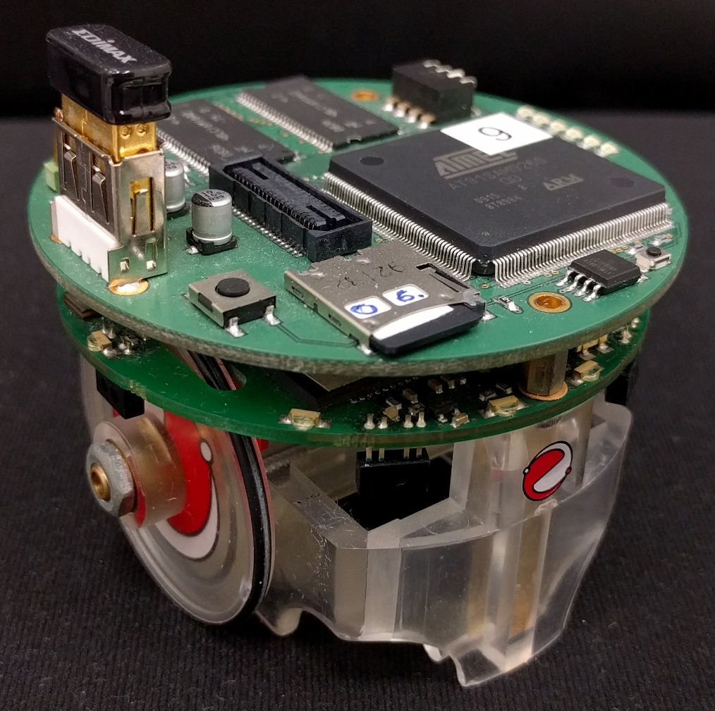
Hardware
BACKGROUND
Practical work carried out at the York Robotics Laboratory
Initial target robot platform is the ‘e-puck’ robot
Robotics education and research platform
Widely used in multi-robot and swarm research
Configured with a Linux extension board and WiFi adapter

Slide 7
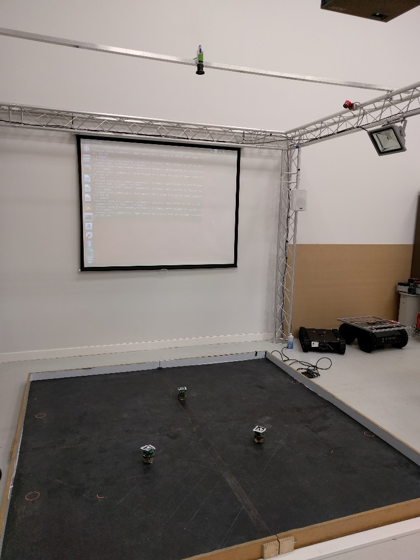
Hardware
BACKGROUND
Machine vision camera used for tracking.
Machine vision camera
Positioned directly above robot arena
Tracks the robots using the ARuCo tag detection system

Slide 8
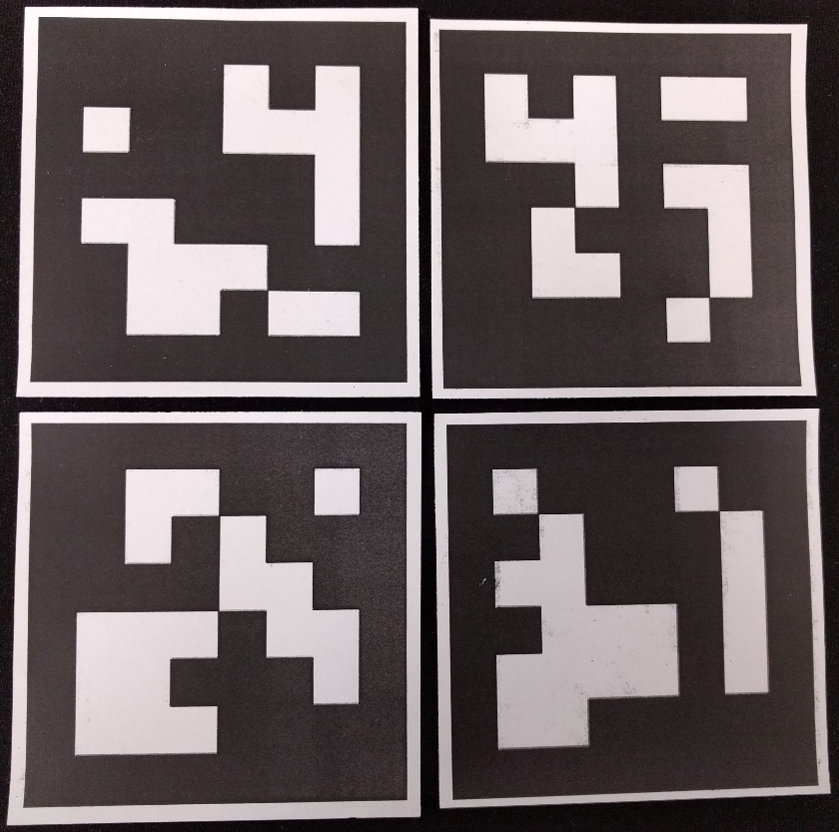
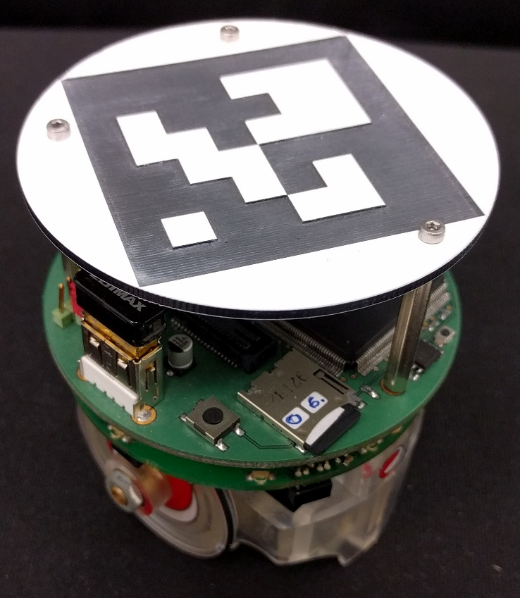
Hardware
BACKGROUND
Left: Four printed ARuCo tag markers. Right: An e-puck robot with a laser cut ARuCo marker header attached.
S. Garrido-Jurado, et al., Automatic generation and detection of highly reliable fiducial markers under occlusion, Pattern Recognition, Volume 47, Issue 6, June 2014, Pages 2280-2292, ISSN 0031-3203

Slide 9
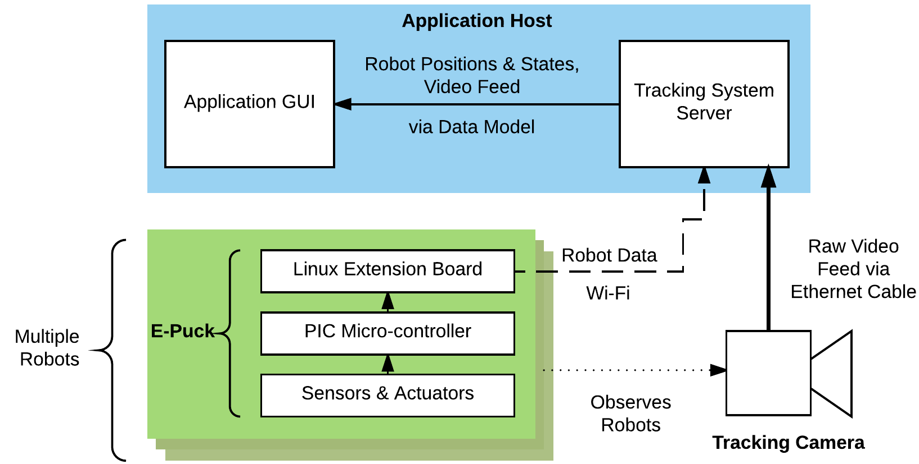
System Architecture
Design
Robots communicate data over WiFi
Camera sends images via Ethernet
Application formed of a server portion and a UI

Slide 10
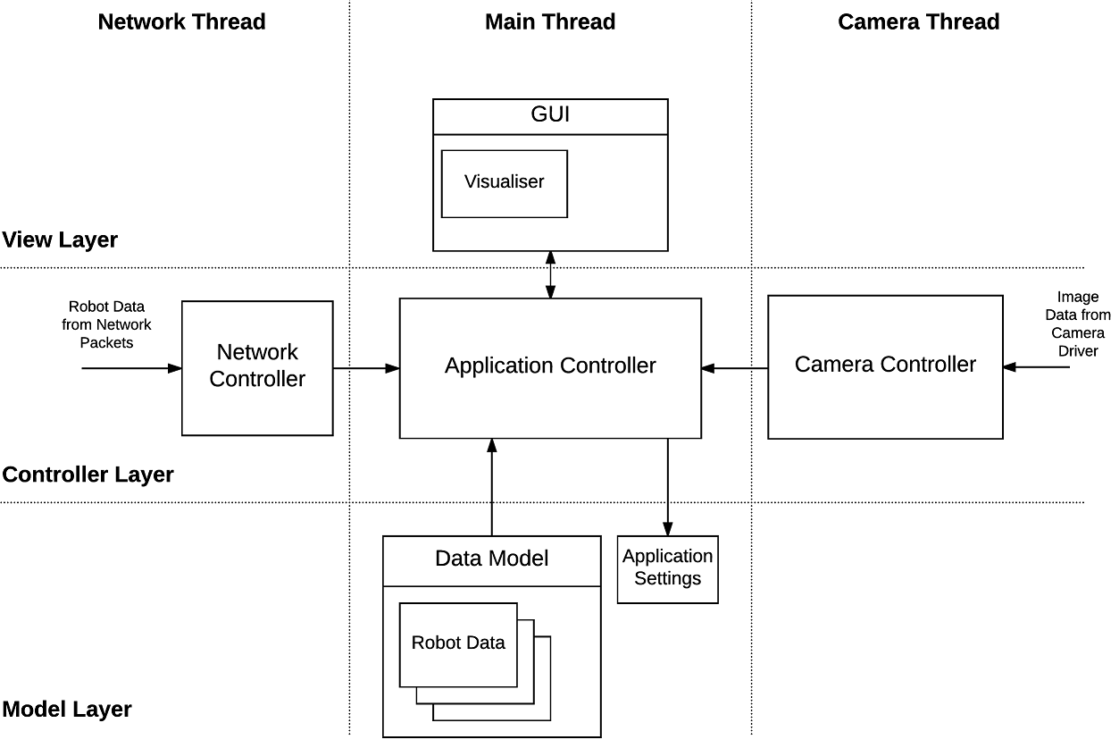
software Architecture
Design
Model View Controller architecture
Model stores data about the robot
View displays the data through the UI and augmented video
Controller handles receiving data, updating the model, reading the camera
Application is threaded to improve performance
Modular design to improve future extensibility

Slide 11
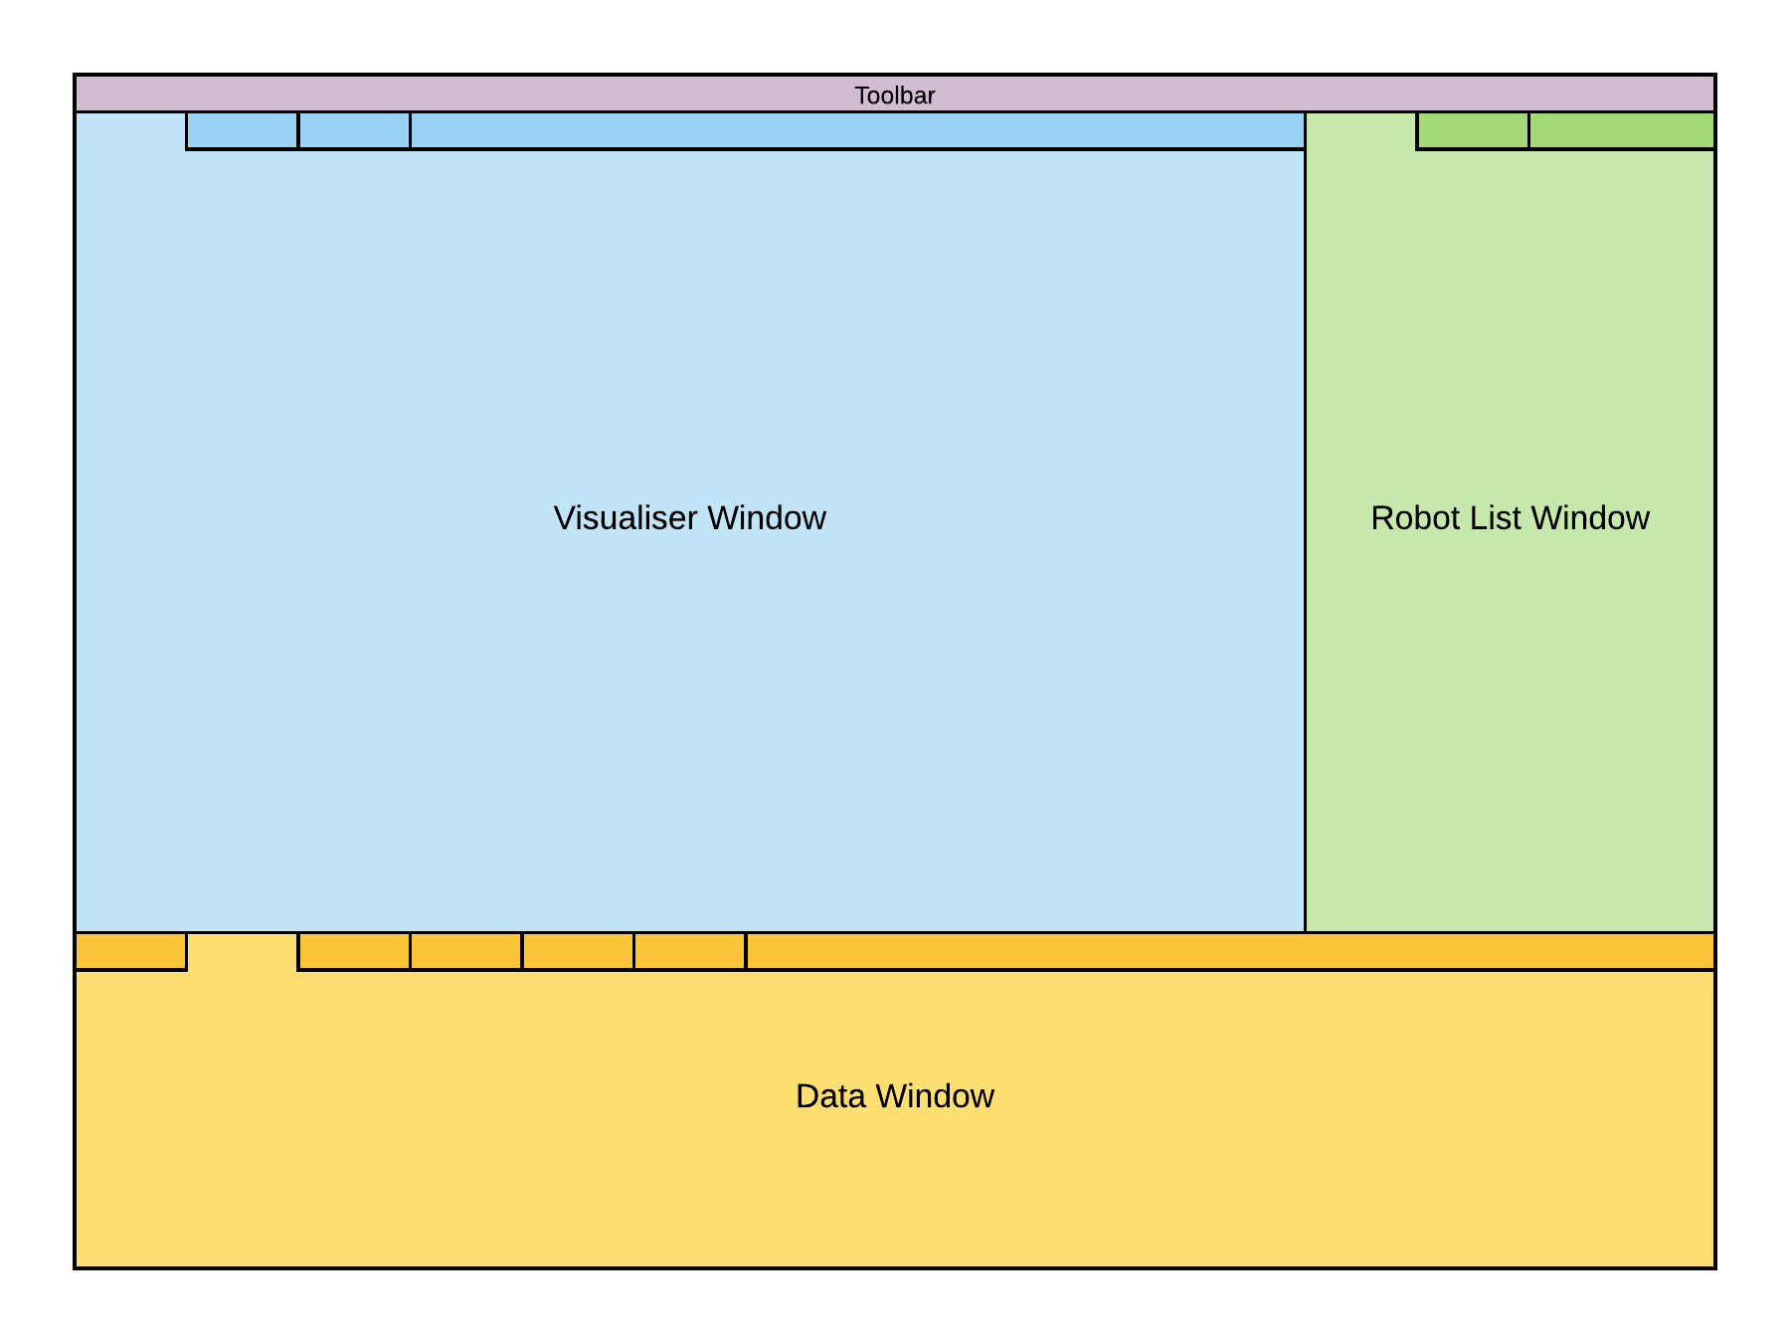
UI design
Design
3 main panels, Visualiser, Robot List and Detail
UI created using the popular Qt GUI framework

Slide 12
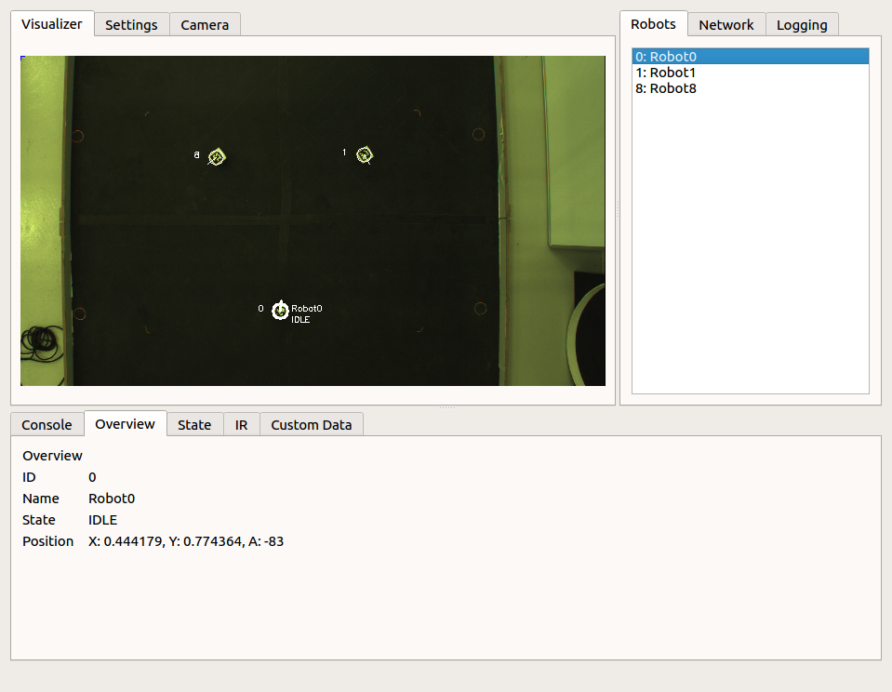
UI design
Design

Slide 13
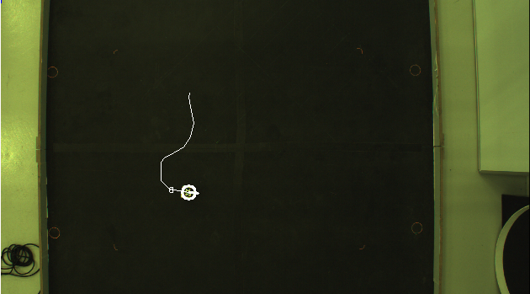
Application
Progress
Implemented in C++
All core aspects of the application have been implemented
Robot tracking and video feed augmentation
Image processing managed using OpenCV
Tracking the position and orientation of three robots.
Displaying the tracked path history of a moving robot.

Slide 14
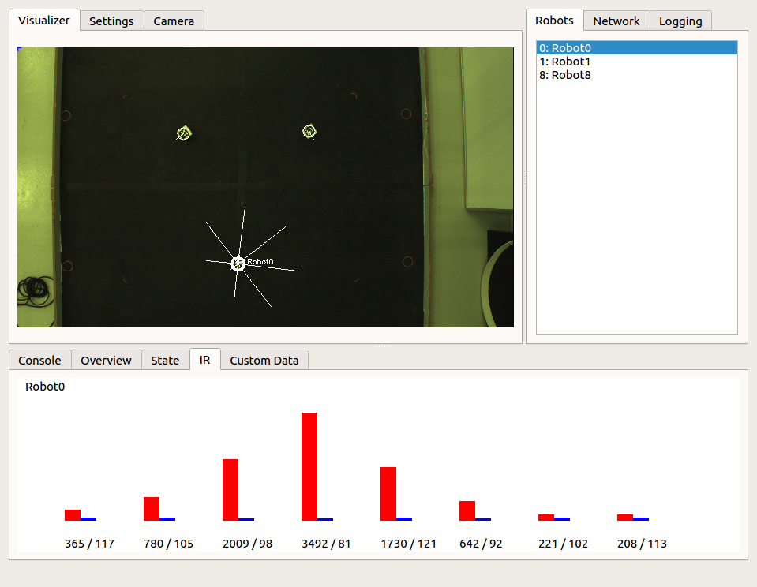
Application
Progress
Several data types implemented in both data model and UI
Here the IR data for robot 0 is being examined. This includes a graphical representation in the visualiser and details of the raw data in the details panel.

Slide 15
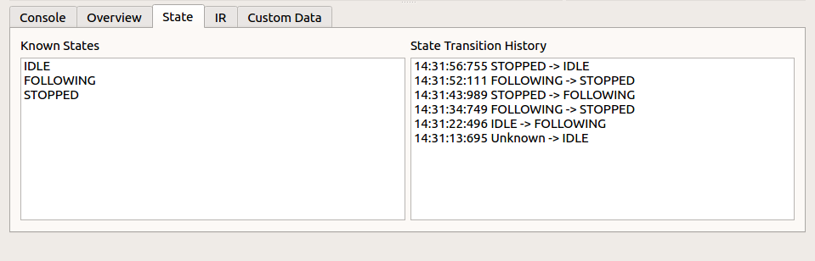
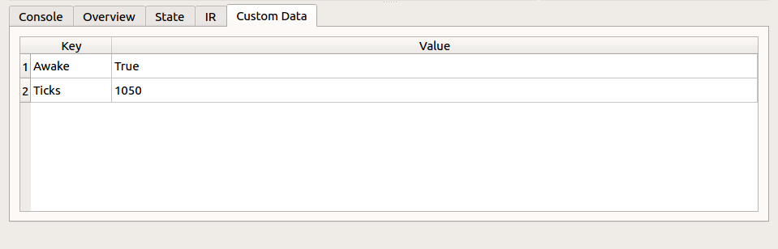
Application
Progress
Several data types implemented in both data model and UI
Here the states and state transition history of one of the robots is examined in the details panel.
This tab shows the custom data reported by one of the robots. The application supports an unlimited number of custom key-value pairs, defined on the robot side.

Slide 16
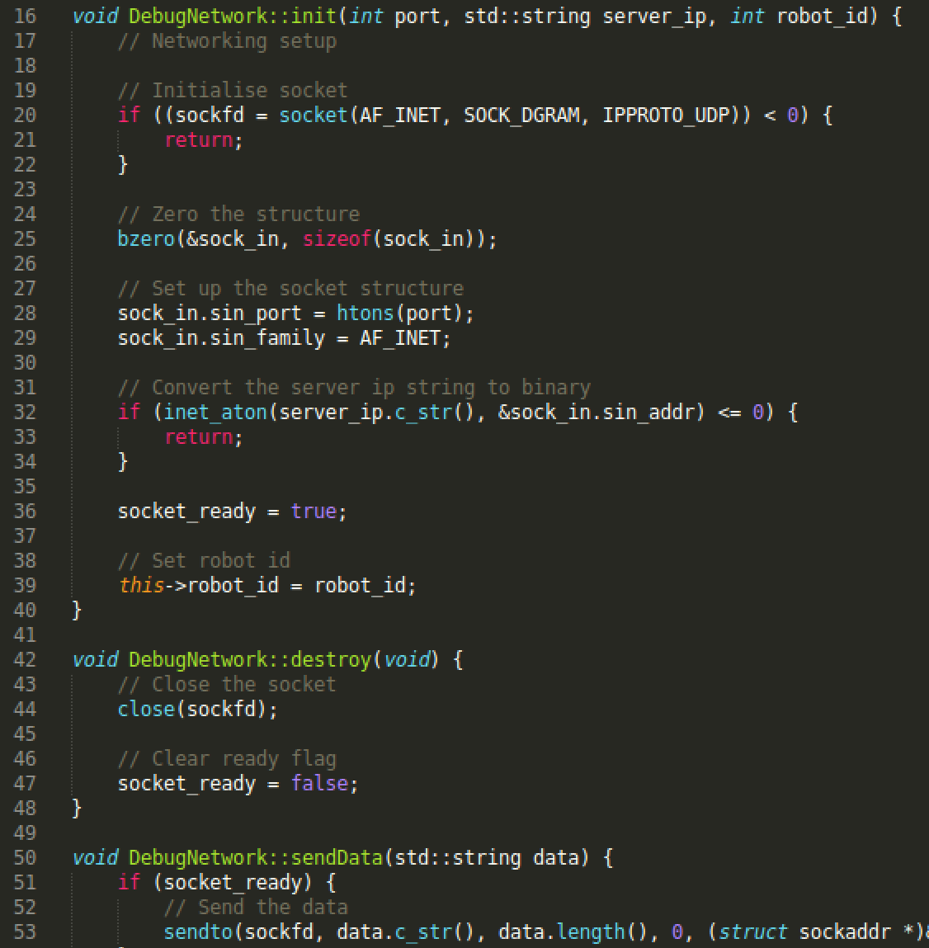

Robot Code
Progress
Networking code
Accessed through single-class API
Implemented in C++
Portable

Slide 17
Remaining Features
Future Work
Additional data types
Accelerometer / gyroscope
Battery level
Further develop graphical overlays
Greater user configuration of overlays and data
Data logging

Slide 18
Testing and Evaluation Strategy
Future Work
Formal testing work yet to be completed
Manual user interface testing
Unit testing of data model
Verification testing of the system as a whole
Evaluation through observed user trials
Users will be asked to monitor a swarm and attempt to solve a deliberate bug
Followed by a questionnaire about the system’s usability and design

Slide 19
Potential future Development
Future Work
This system could be developed into a full swarm robotics research platform
Record and export data from swarm robotics experiments
Perform data processing and macro-level analysis in real time
Export video of experiment runs
Allow for bi-directional communication with the robots to send instructions
Extend to more robot platforms
The robot side code should be relatively easy to port to other robots
Implement support for Bluetooth as well as WiFi for data transfer
Ported to a more comprehensive AR platform
Microsoft Holo-lens integration would allow for more immersive human-robot interaction

Slide 20
Conclusion
Developed in order to tackle issues with debugging swarm robotics systems in real time.
Designed with a focus on modularity, extensibility, with an MVC architecture in mind.
Implementation stage is almost complete, with testing and evaluation to begin soon.
Potential to be developed into a full Swarm Robotics research platform in the future.

Slide 21
Thank you for Listening
Conclusion
Feel free to ask any questions

